Slide 1
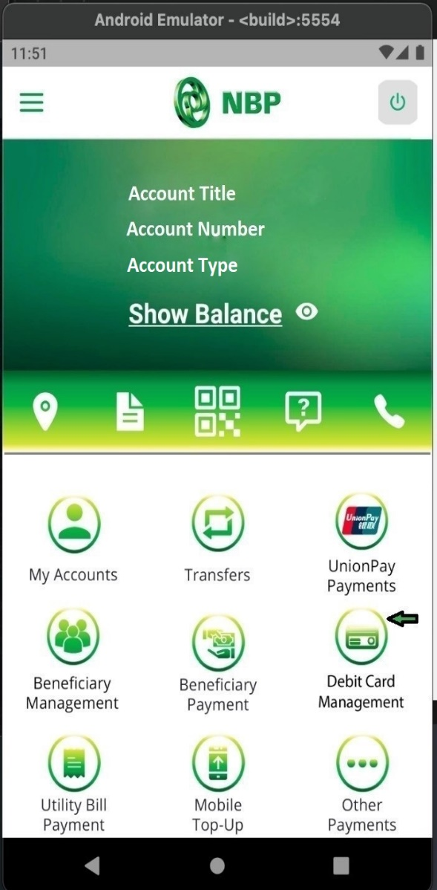
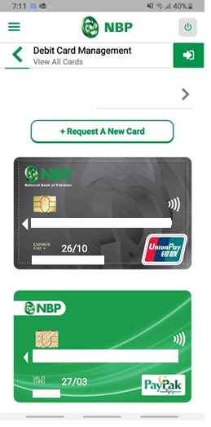
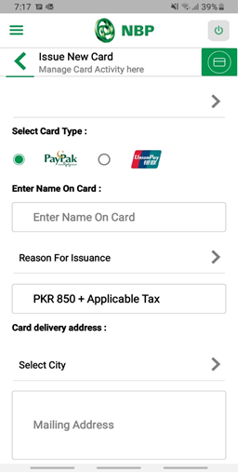
How to Order a New Card?
Tap on “Debit Card Management”
Step-1
Tap on Request a New Card
Select Card of your choice and input required details
Step-2
Step-3

Slide 2
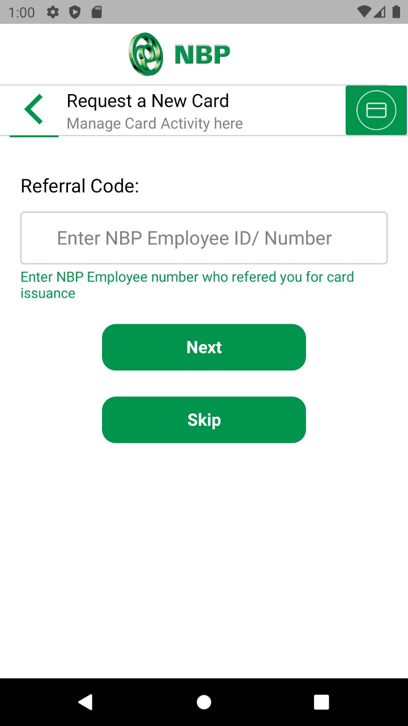
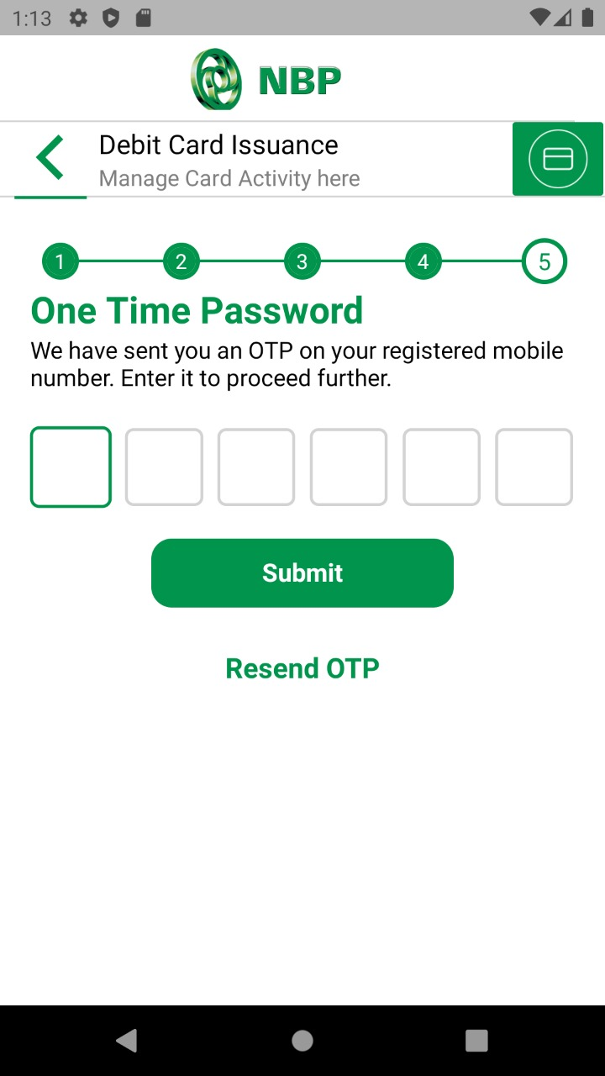
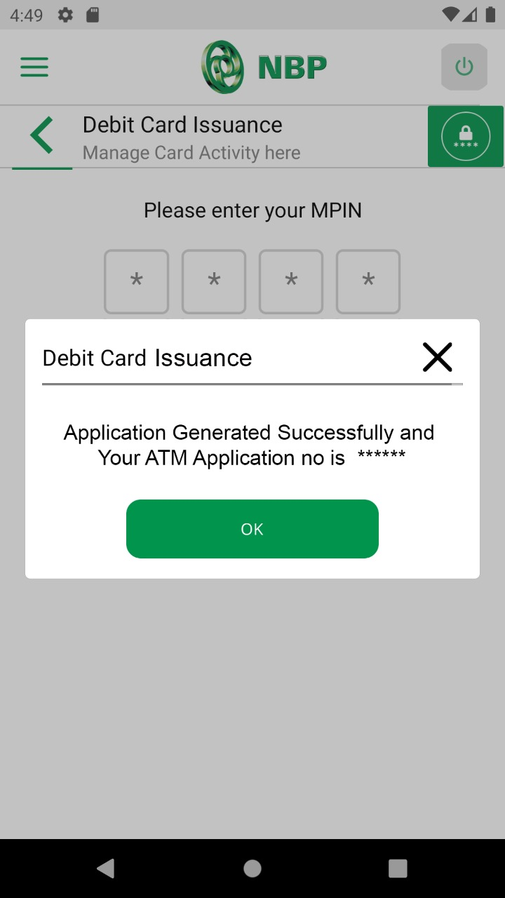
Enter NBP Employee ID/number (Optional)
Enter OTP & Tap on Submit button.
Successful Card request notification will appear on screen.
Step-4
Step-5
Step-6

